Slide 1




Help+Us
Disaster Management System for Sri Lanka
Vidushan Prabash
HD 05
Student ID:
HD0520018
Keshari Hasithangi
UOG 01
Student ID: UOG/BSC/IS/2021/1/00007

Slide 2
Help+Us
Disaster Management System for Sri Lanka
Vidushan Prabash
HD 05
Student ID:
HD0520018
Keshari Hasithangi
UOG 01
Student ID: UOG/BSC/IS/2021/1/00007
Table of Content
Introduction
Intended Audience
Scope of the project
System Modeling
Tools and Technologies used
Project Schedule
Project Contributions
Limitations and Conclusion

Slide 3

Table of Content
Introduction
Intended Audience
Scope of the project
System Modeling
Tools and Technologies used
Project Schedule
Project Contributions
Future works and Conclusion

Slide 4
Table of Content
Introduction
Intended Audience
Scope of the project
System Modeling
Tools and Technologies used
Project Schedule
Project Contributions
Limitations and Conclusion
1. Introduction
In the face of disasters, individuals often find themselves in a state of helplessness and uncertainty. Whether the disaster is critical or not, the need for assistance is universal. In such situations, people are often unprepared and lack a clear understanding of the necessary steps to take. HELP+US aims to address these challenges by providing a comprehensive platform that enables users to assess the current disaster situation and take proactive measures to mitigate risks.

Slide 5


1. Introduction
In the face of disasters, individuals often find themselves in a state of helplessness and uncertainty. Whether the disaster is critical or not, the need for assistance is universal. In such situations, people are often unprepared and lack a clear understanding of the necessary steps to take. HELP+US aims to address these challenges by providing a comprehensive platform that enables users to assess the current disaster situation and take proactive measures to mitigate risks.

Slide 6
1. Introduction
In the face of disasters, individuals often find themselves in a state of helplessness and uncertainty. Whether the disaster is critical or not, the need for assistance is universal. In such situations, people are often unprepared and lack a clear understanding of the necessary steps to take. HELP+US aims to address these challenges by providing a comprehensive platform that enables users to assess the current disaster situation and take proactive measures to mitigate risks.
2. Intended Audience
Mostly, in Sri Lanka most of the people not aware about the disasters beforehand or they are not aware of things to be followed during and after a disaster. So the audience for this HELP+US Disaster Management System mainly focus on the general public in Sri Lanka.

Slide 7
2. Intended Audience
Mostly, in Sri Lanka most of the people not aware about the disasters beforehand or they are not aware of things to be followed during and after a disaster. So the audience for this HELP+US Disaster Management System mainly focus on the general public in Sri Lanka.

Slide 8
2. Intended Audience
Mostly, in Sri Lanka most of the people not aware about the disasters beforehand or they are not aware of things to be followed during and after a disaster. So the audience for this HELP+US Disaster Management System mainly focus on the general public in Sri Lanka.
3. Scope of the project
Display real-time disaster locations on the map.
Display temporary and safe shelters.
Guide the users by giving the instructions to follow before, during and after a disaster.
Help victims using donations.

Slide 9

3. Scope of the project
Display real-time disaster locations on the map.
Display temporary and safe shelters/camps.
Guide the users by giving the instructions to follow before, during and after a disaster.
Help victims using donations.

Slide 10

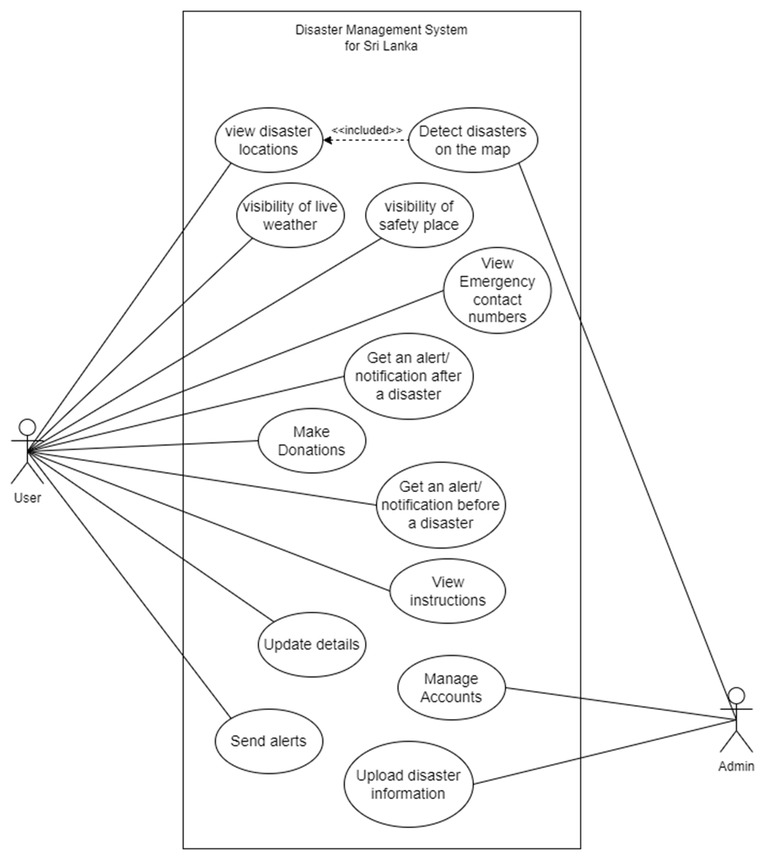
3. Scope of the project
Display real-time disaster locations on the map.
Display temporary and safe shelters.
Guide the users by giving the instructions to follow before, during and after a disaster.
Help victims using donations.
4. System Modeling

Slide 11
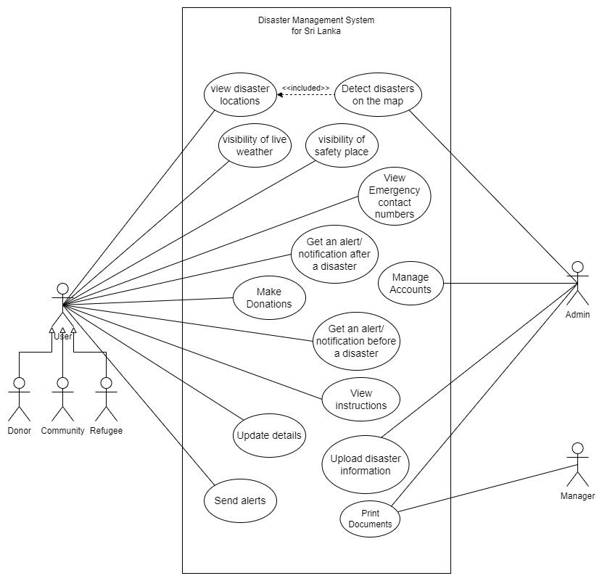
4. System Modeling

Slide 12

4. System Modeling
5. Tools and Technologies used
Hardware | Desktop - allows users to do operations using the Graphical user interfaces (GUI).
Languages | Python – use to develop the back end of a web application.
Languages | Java Script - use to make web pages more dynamic.
Languages | HTML – use to structure the web page and its content.
Languages | CSS – use to create different layouts on web pages.
Platforms | Django – is a framework used to develop the backend of a web application.
Database | SQLite - Is a lightweight, serverless, and self-contained database engine that is suitable for projects with low to moderate database traffic.
Development Environment | VSCode - is a free, open-source code editor known for its simplicity, speed, and extensibility.

Slide 13
5. Tools and Technologies used
Hardware | Desktop - allows users to do operations using the Graphical user interfaces (GUI).
Languages | Python – use to develop the back end of a web application.
Languages | Java Script - use to make web pages more dynamic.
Languages | HTML – use to structure the web page and its content.
Languages | CSS – use to create different layouts on web pages.
Platforms | Django – is a framework used to develop the backend of a web application.
Database | SQLite - Is a lightweight, serverless, and self-contained database engine that is suitable for projects with low to moderate database traffic.
Development Environment | VSCode - is a free, open-source code editor known for its simplicity, speed, and extensibility.

Slide 14
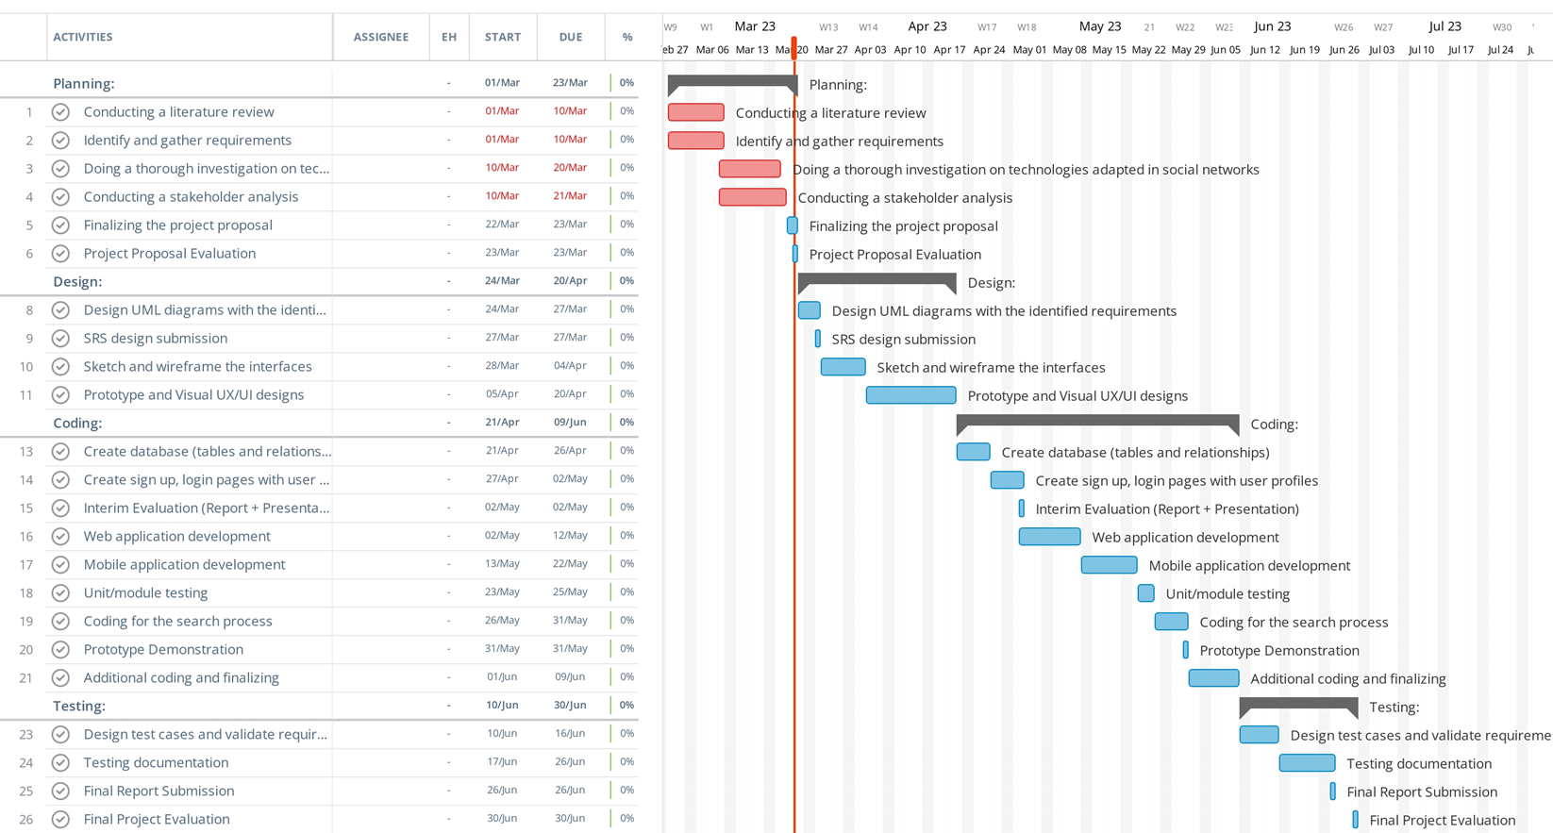
Hardware | Desktop - allows users to do operations using the Graphical user interfaces (GUI).
Languages | Python – use to develop the back end of a web application.
Languages | Java Script - use to make web pages more dynamic.
Languages | HTML – use to structure the web page and its content.
Languages | CSS – use to create different layouts on web pages.
Platforms | Django – is a framework used to develop the backend of a web application.
Database | SQLite - Is a lightweight, serverless, and self-contained database engine that is suitable for projects with low to moderate database traffic.
Development Environment | VSCode - is a free, open-source code editor known for its simplicity, speed, and extensibility.
6. Project Schedule
Initial Project Plan

Slide 15
6. Project Schedule
Estimated Project Plan

Slide 16
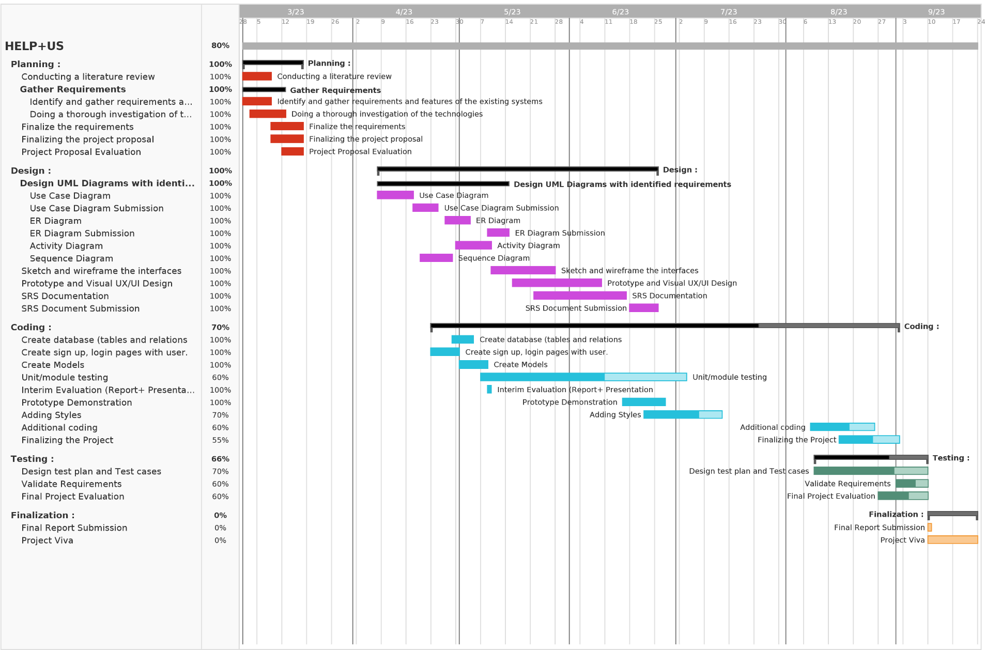
6. Project Schedule
Initial Project Plan
Final Project Plan

Slide 17
6. Project Schedule
Actual Project Plan

Slide 18
7. Project Contributions
Project Proposal Document - By Keshari & Vidushan
The project proposal outlines the purpose, goals, and objectives of the disaster management system for Sri Lanka.
SRS Document - By Keshari & Vidushan
Collaborative effort that refer into the technical aspects of the project, focusing on software requirements
Designing Contribution - By Keshari & Vidushan
Collaborative effort for Designing includes creating the architecture, user interfaces, overall structure of the system using class, use case, activity, sequence diagram

Slide 19
7. Project Contributions
Development Contribution
Vidushan - Sign up, login, Edit Profile, Home page, Donate page, Displaying Disaster Guidelines and apply styles
Keshari – Sign up, login, Edit Profile, Generating reports, Display Disaster locations and Safety camps on map, Camp Registration, Refugee Registration, Location Registration, Displaying Disaster Guidelines and apply styles
Finale Report Contribution - By Keshari
Summarize the entire project including designs, challenges, Future works, Overall outcome, contributions through out the project and lesson learned

Slide 20
7. Project Contributions
Public Contributions
The Irrigation Department - is expertise in flood control which their data and insights are essential for understanding and mitigating the impact of floods.
National Building and Research Organization (NBRO) - NBRO plays a vital role in providing crucial data and regulatory support related to landslides. Their expertise in understanding geological factors that contribute to landslides is invaluable which provides up-to-date information about rainfall details and landslide details.

Slide 21
7. Project Contributions
National Building and Research Organization (NBRO) - NBRO plays a vital role in providing crucial data and regulatory support related to landslides. Their expertise in understanding geological factors that contribute to landslides is invaluable which provides up-to-date information about rainfall details and landslide details.
The Irrigation Department - is expertise in flood control which their data and insights are essential for understanding and mitigating the impact of floods.
8. Limitations
Reliability of the system depends on the accuracy of real-time data.
·Sending an alert before a disaster using an SMS.
Implement the system for other various disaster types.

Slide 22
8. Future Works
Display water level details on map by uploading a document according to the hazard areas
Implement the system for other areas and other disaster types in Sri Lanka
Sending an alert before a disaster using an SMS.
Implement the camp donation functionality.
Manage accounts

Slide 23
Summary
In conclusion, our goal to develop the HELP+US disaster management system for Sri Lanka aim to minimize the impact of disasters and protect the lives and livelihoods of the people in Sri Lanka. Continuous improvement, adaptability, and community involvement will be crucial in ensuring the system's long-term success.

Slide 24
Thank you...

Slide 25
Thank you...

